Slide 1

ILLINOIS FIREARM DEALER LICENSE CERTIFICATION ACT:
HOW TO APPLY: BUSINESS ACCOUNT & APPLICATION
ILLINOIS STATE Police
FIREARMS SERVICES BUREAU
Version 4: December 2020
1

Slide 2
REQUIREMENTS TO COMPLETE AN APPLICATION
Type of Internet Browser to Use:
  Google Chrome
  Internet Explorer (IE)
  Firefox
  Safari
  Microsoft Edge – Do not recommend using. You may find that the application does not work properly.
15 Minute Session Timeout:
  Once you begin the application, there is a 15 minute no activity session timeout. If you do not click or type anything for 15 minutes you will be logged-off and will have to complete the application from the beginning. Information will not be saved.
  Important – Be sure you only have one internet tab or window open while completing your application. Multiple tabs or windows open at the same time can cause another session’s timer to be applied to the FDLC application instead of the active one you are using to complete your application. This will cause you to be logged-off even though you are actively clicking or typing in the application.
DOES NOT AUTOMATICALLY SAVE: You have to complete the entire application once you begin. If not, you will be required to start from the beginning. It is important to have all of your required documents stored on your computer (desktop / laptop) before beginning the application process. (i.e. Safe Storage Plan, affidavits, copy of your FFL License, etc…) It is not recommended you use a smart phone to complete an application.
2

Slide 3
FIREARM DEALER LICENSE CERTIFICATION
PRE-APPLICATION CHECKLIST
Please have the following items completed prior to attempting your application to make the process as easy as possible:
Complete the Firearm Dealer License Certification Training titled “Illinois Firearm Transfers Training for Certified Licensees” located at http://www.isp.state.il.us/firearms/fdlc/training.cfm. This includes all owners, agents and employees engaged in the transferring of firearms. In the application, “date of review” will be captured for the completion of training.
Determine whether your Federal Firearms License (FFL) is a retail or non-retail location. The Act defines a retail location as, “…a store open to the public from which a certified licensee engages in the business of selling, transferring, or facilitating a sale or transfer of a firearm…”
To help make this determination, here are three scenarios and how they would be defined:
  A big box store open to the public during hours of operation with a displayed inventory where the public can purchase and receive transfers of firearms. This is a RETAIL location.
  A residential dealer who has a designated area within his or her home, such as a garage or separate area, wherein during hours of operation, the public is able to come into this area to make purchases and receive transfers. This is a RETAIL location.
  A residential dealer who is not open to the general public, who conducts firearm transfers with individuals known to the dealer or who sets appointments for firearms transfers. This is a NON-RETAIL location.
Have your Federal/Employer Tax ID & State Tax ID readily available, if applicable. This information will be collected on the electronic application; however, you are not required to provide it.
Create a copy of your FFL(s) in a digital format.
Have a signed and notarized affidavit in a digital format to cover all owners, agents, and employees who sell or transfer firearms, including proof of a background check for out-of-state owners, agents, and employees. Affidavits are located at http://www.isp.state.il.us/firearms/fdlc/forms.cfm.
Complete a signed and notarized affidavit in an uploadable format certifying the status of the FFL. Affidavits are located at http://www.isp.state.il.us/firearms/fdlc/forms.cfm.
Have all FOID card information (FOID# & Expiration Date) for owners, agents, employees (if applicable) readily available.
This will be required on the affidavit and within the application.
Ensure the device that you are using has all the aforementioned documents available and in a location where you can easily access them.
Using the template and instructions, complete a Safe Storage Plan if you operate a retail location.
Register by creating a Business User Account. http://www.isp.state.il.us/firearms/fdlc/fdlcApplication.cfm
Application payment will be collected via ACH (or e-check) - $300 for a non-retail location, $1,200 for a retail location. At payment, you will be asked for your bank’s routing and account numbers. These numbers can be found at the bottom of your bank check. On the bottom far left is your bank’s 9-digit routing number, followed by your account number, then the check number. You will need this information to process your payment.
3

Slide 4
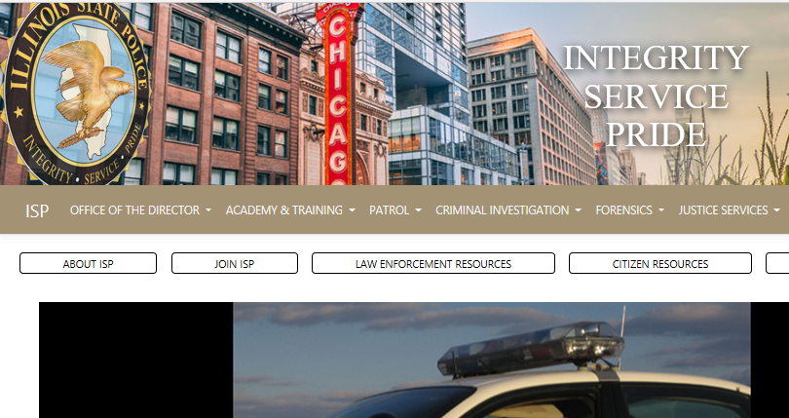
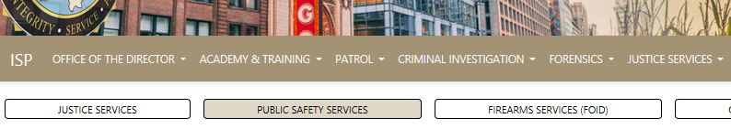

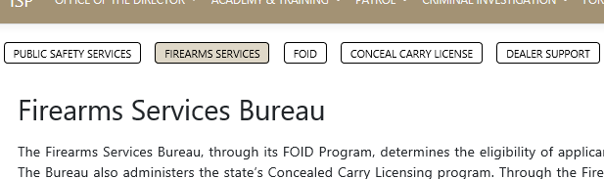

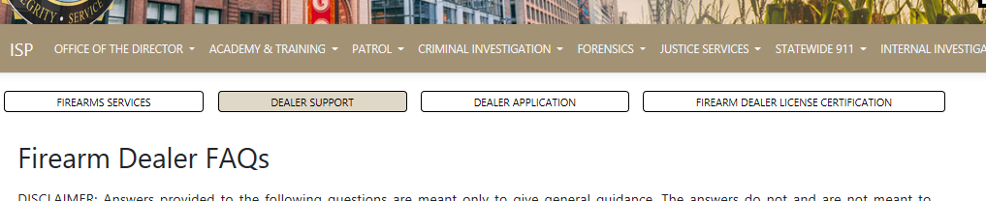
How to Navigate to the Firearm Dealer License Certification Program Website
Start by going to the Illinois State Police website: http://www.isp.Illinois.gov/
Click on the “JUSTICE SERVICES” tab on the top. From the dropdown menu, select PUBLIC SAFETY SERVICES. Then, select FIREARMS SERVICES (FOID). Then, select DEALER SUPPORT. Finally, select FIREARM DEALER LICENSE CERTIFICATION.
4

Slide 5
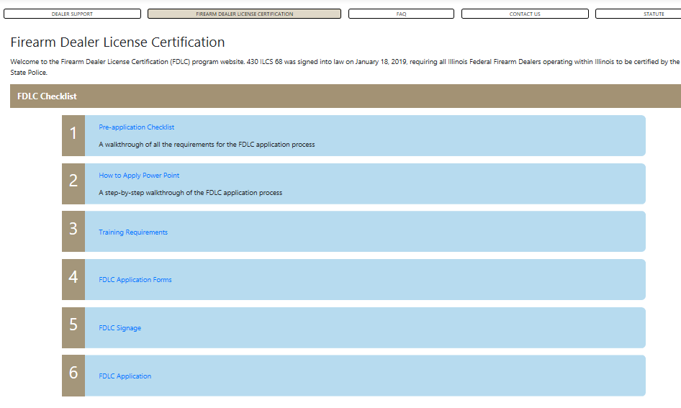
Items to Review and Fill Out Before You Start Your Business Account & Application
Start by clicking on 1) “Pre-application Checklist”. This will let you know what items you will need before you apply. Be sure to have these items filled out and saved to a location on your computer which allows them to be easily uploaded later on in the application process.
5

Slide 6
Items to Review and Fill Out Before You Start Your Business Account & Application
It is highly recommended that you print this PowerPoint slideshow which will guide you through both the creation of your Business Account and submission of your Application step-by-step. Continue to follow the numbers in order.
6

Slide 7
Items to Review and Fill Out Before You Start Your Business Account & Application
When you reach number 6 in the list, and have all required documentation and forms completed, you are ready to create your Business Account. Your Business Account must be created first before you can begin your application. Click on “FDLC Application” which will direct you to additional links including the Business Account Registration link.
Please review the statute in its entirety. A list of FAQs are provided for additional guidance.
7

Slide 8
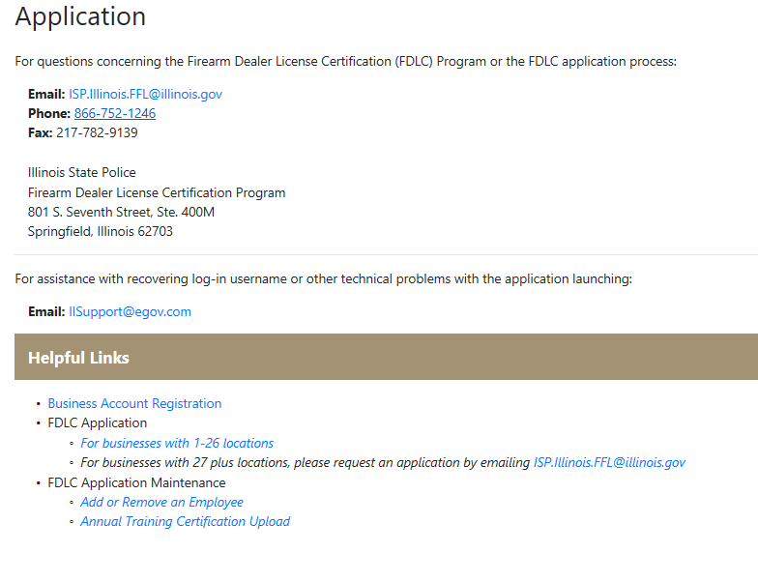
STEP 1: CREATE YOUR BUSINESS ACCOUNT
First, you must click on the “Business Account Registration” hyperlink to create your business account. This is required before you can complete your application.
If you need help with your log-in username or other technical problems for the business account or application launching issues, email the support link
8

Slide 9
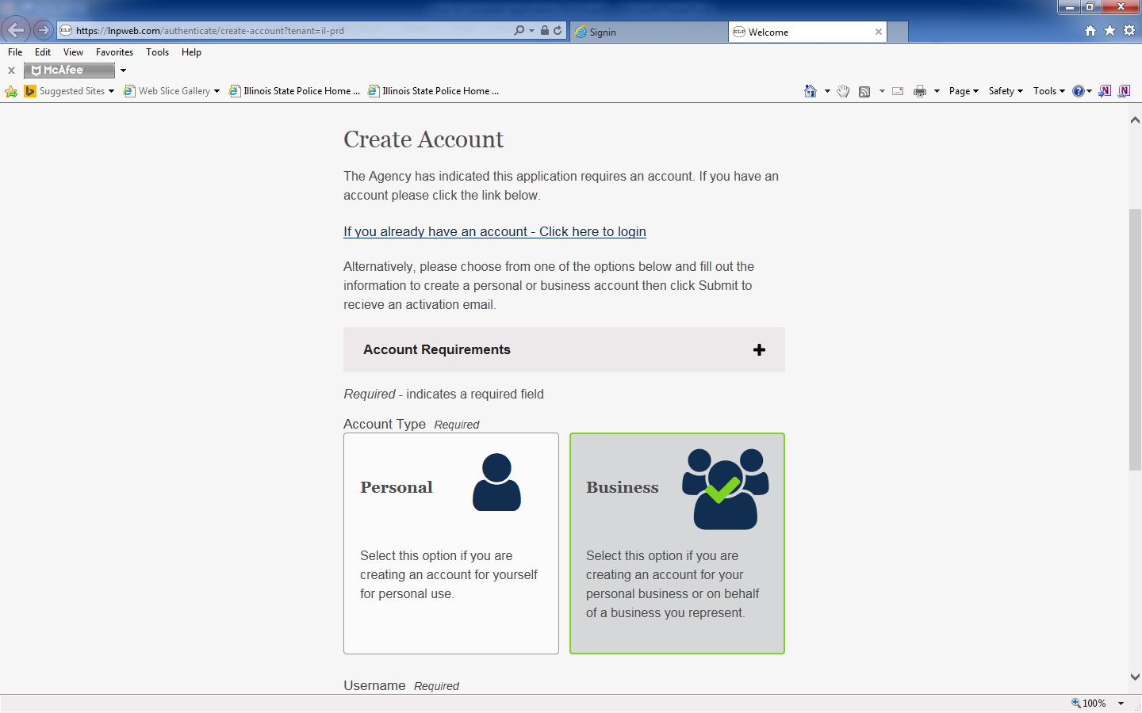
STEP 1: CREATE YOUR BUSINESS ACCOUNT
Select “Business” as your account type. This is for both retail and non-retail locations.
DO NOT SELECT
9

Slide 10
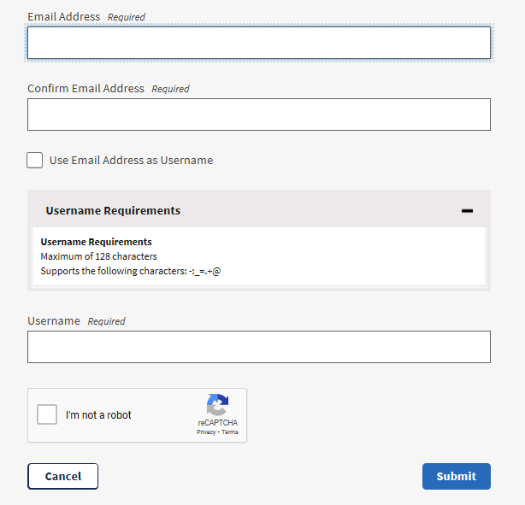
STEP 1: CREATE YOUR BUSINESS ACCOUNT
Reminder: Be sure to write down your USERNAME exactly how you created it since it is case sensitive. The lower and UPPER case characters you used to create your username are important to remember. (Example: UsERnaMe)
Username Requirements
Maximum of 128 characters
Supports the following characters:
(A-Z, a-z, 0-9, -:_=.+@)
Enter a username. It is recommended you write your username down and place it in a secure area. ISP recommends using (first name, last name/first 3 and last 5 of your FFL#)
Enter your email address twice.
Check the box “I’m not a robot”. Follow the instructions for it to verify. Once done click “Submit”
10

Slide 11
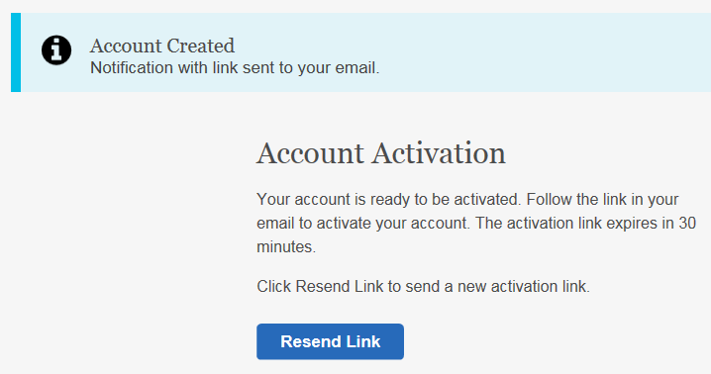
STEP 1: CREATE YOUR BUSINESS ACCOUNT
Open your email account (Gmail, Yahoo, etc.) used during your Business Account Registration (slide #10). A hyperlink will be sent to you in email to complete the activation of your Business Account.
11

Slide 12
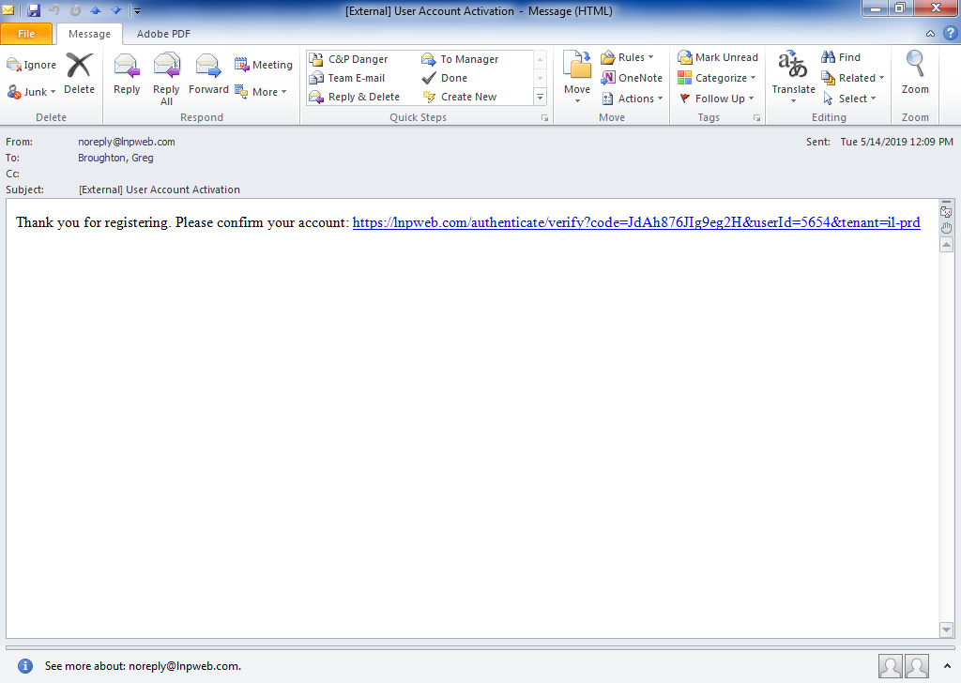
STEP 1: CREATE YOUR BUSINESS ACCOUNT
Below is an example of the email message and hyperlink you will receive. Click on the blue link. This will activate your account.
If your link is not highlighted in blue, it may not be a hyperlink. It this case, you will need to copy and paste the (HTTPS://) link into your web browser and press the enter key.
12

Slide 13
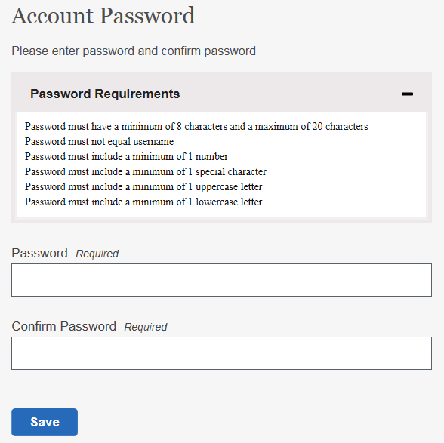
STEP 1: CREATE YOUR BUSINESS ACCOUNT
Now that you have activated your account, you will continue to finalize your business account access.
Password Requirement:
- Password must have a minimum of 8 characters and a maximum of 20 characters
- Password must not equal username
- Password must include a minimum of 1 number
- Password must include a minimum of 1 special character
- Password must include a minimum of 1 uppercase letter
- Password must include a minimum of 1 lowercase letter
Enter a password by following the above requirements. Click “Save.” Be sure you store your password in a secure area.
13

Slide 14
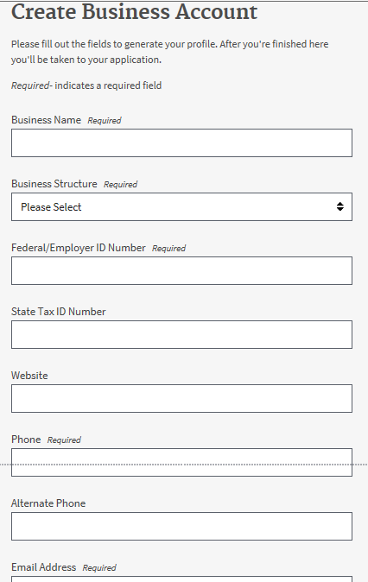
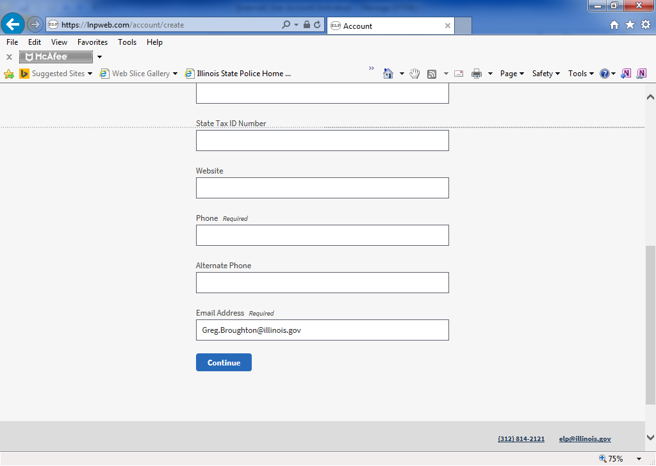
STEP 1: CREATE YOUR BUSINESS ACCOUNT
Enter in the required information. Please feel free to add any optional information as well. Then select “Continue” at the bottom.
The email address you entered previously will automatically populate in this field.
14

Slide 15
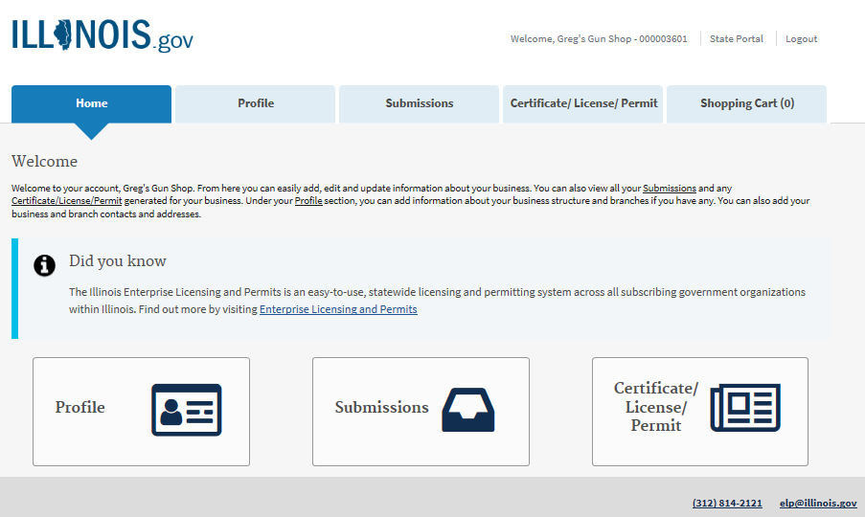
STEP 1: CREATE YOUR BUSINESS ACCOUNT
Congratulations! You are now finished with creating your Business Account on the Illinois Licenses and Permits system. Please LOGOUT and continue with Slide 16 to complete your Firearm Dealer License Certification Application.
15

Slide 16
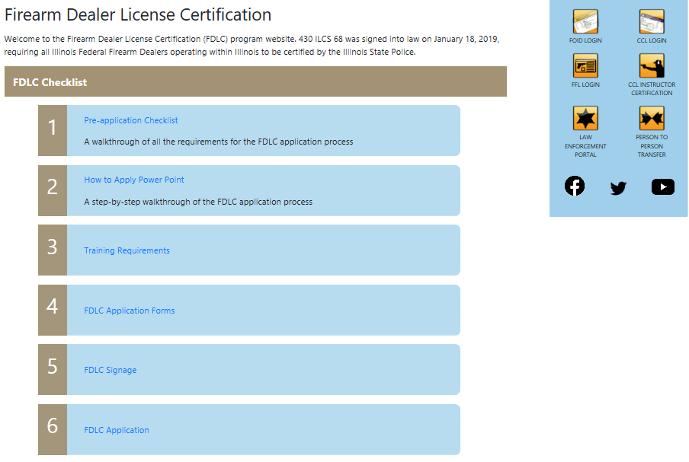
STEP 2: COMPLETE YOUR FIREARM DEALER LICENSE CERTIFICATION APPLICATION
Return to the Firearm Dealer License Certification Program page (use slide #4 if you need help).
Select Number 6 again which will take you to a link to complete your Application.
16

Slide 17
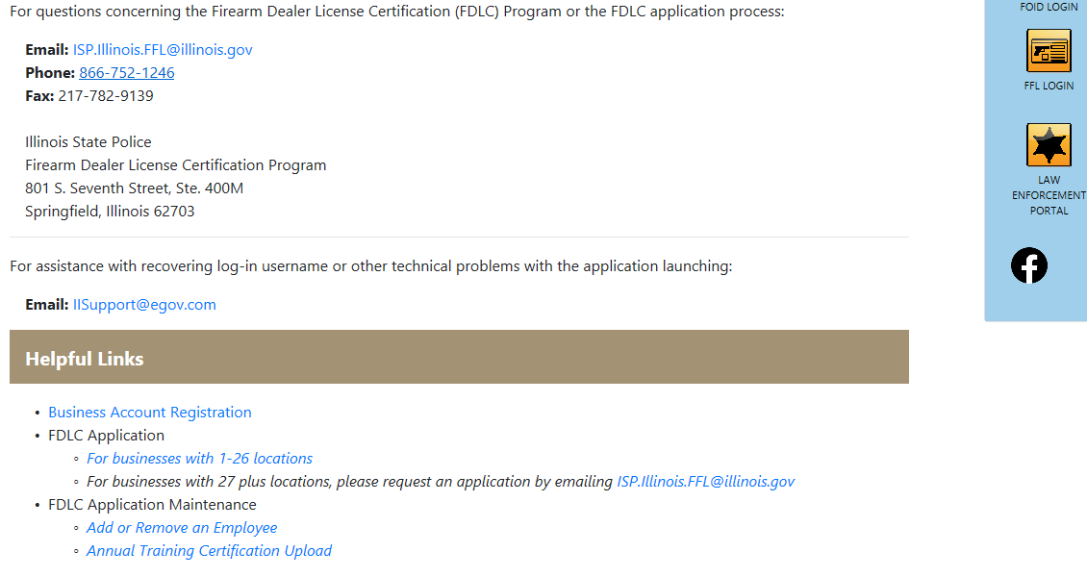
STEP 2: COMPLETE YOUR FIREARM DEALER LICENSE CERTIFICATION APPLICATION
To start your application, select the blue hyperlink “For businesses with 1-26 locations”. If you have more than 26 locations, please send an email to the email provided.
17

Slide 18
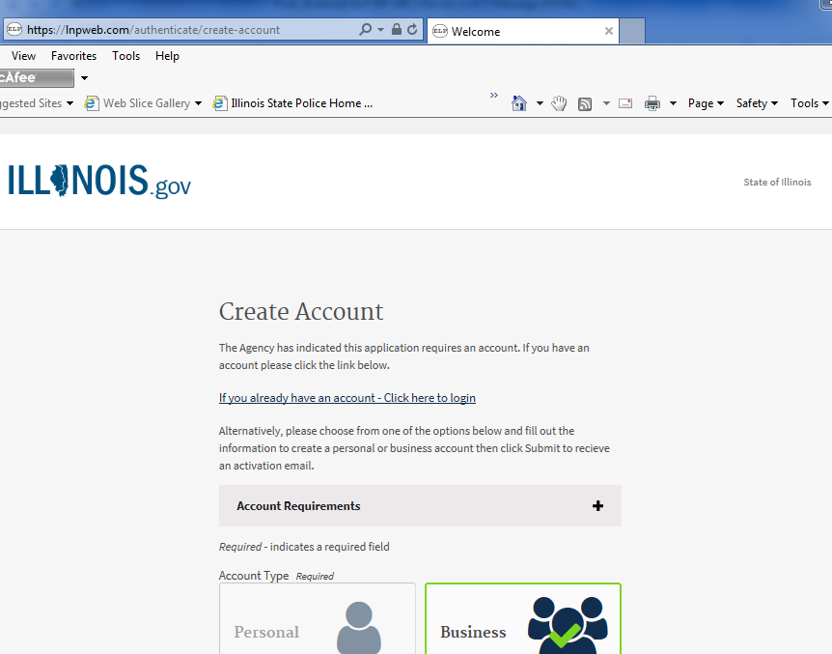
STEP 2: COMPLETE YOUR FIREARM DEALER LICENSE CERTIFICATION APPLICATION
Be sure you only have one internet browser tab or window open.
Left click link to log-in to your account to start your application
18

Slide 19
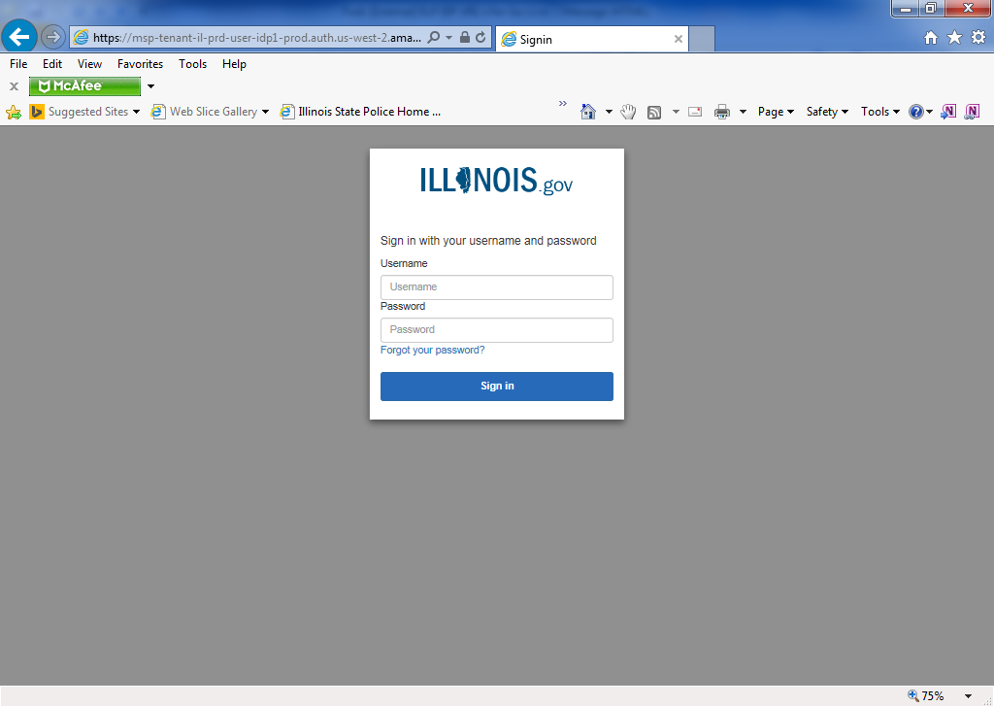
STEP 2: COMPLETE YOUR FIREARM DEALER LICENSE CERTIFICATION APPLICATION
*** (STOP) *** Please ensure you have all of your required documents (Slide #3) saved on your computer before logging into the application.
If you are not actively clicking or typing from this point until you submit your application in its entirety, you will be automatically logged-off within 15 minutes of inactivity and will have to start over from the beginning.
Your application cannot be saved during the process. It must be completed in its entirety once you begin.
Enter your username and password you created in Step 1
19

Slide 20
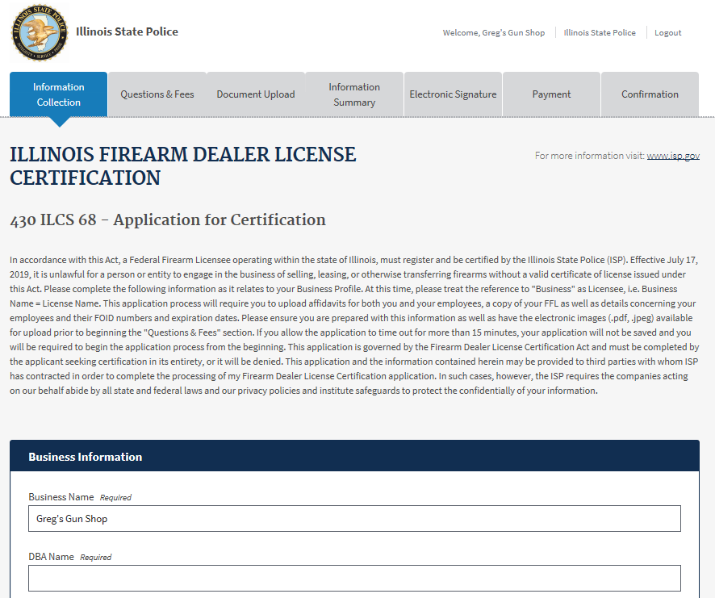
STEP 2: COMPLETE YOUR FIREARM DEALER LICENSE CERTIFICATION APPLICATION
Fill out all required information sections. Read all instructions to ensure you complete your application accurately.
20

Slide 21
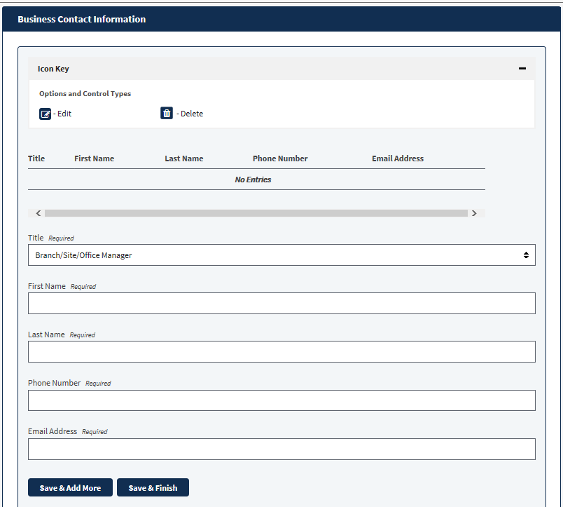
STEP 2: COMPLETE YOUR FIREARM DEALER LICENSE CERTIFICATION APPLICATION
Fill out all required information sections.
Once you have completed all fields, select;
If you have more than one contact to enter, select “Save & Add More”
If you have only one contact to enter, select - “Save & Finish”
You are required to enter at least one business contact.
21

Slide 22
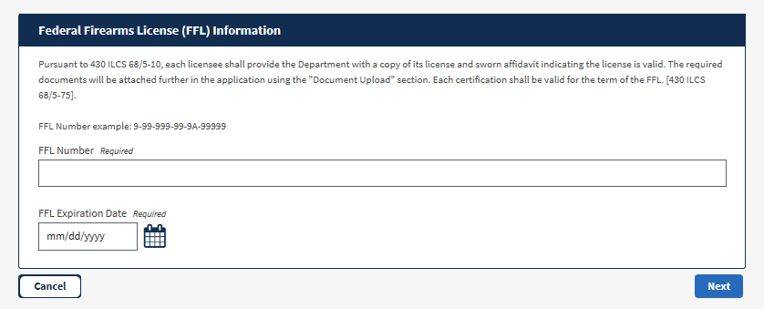
STEP 2: COMPLETE YOUR FIREARM DEALER LICENSE CERTIFICATION APPLICATION
Enter your FFL number including the expiration date. Then select “Next”
22

Slide 23
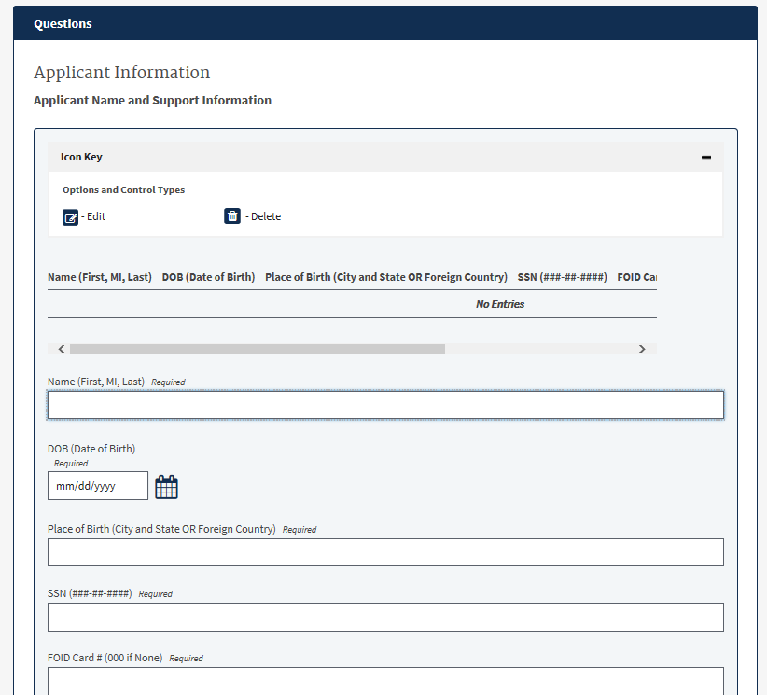
STEP 2: COMPLETE YOUR FIREARM DEALER LICENSE CERTIFICATION APPLICATION
Enter your applicant’s name and support information in this section.
Complete the Responsible Person Information section in the same manner.
23

Slide 24
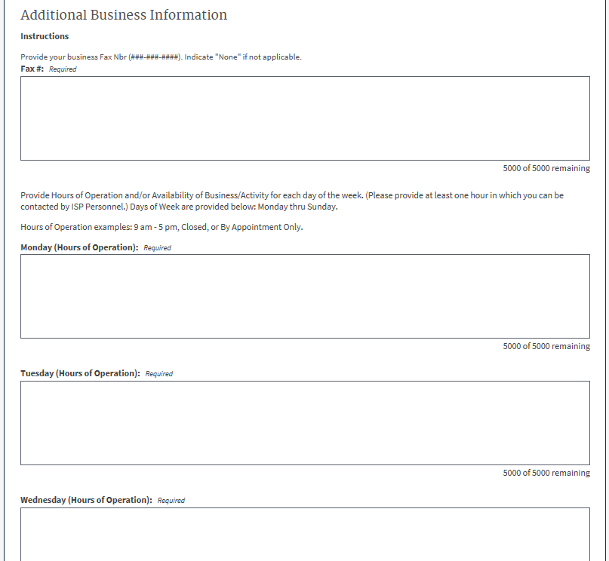
STEP 2: COMPLETE YOUR FIREARM DEALER LICENSE CERTIFICATION APPLICATION
Enter your fax number here. If you do not have one, enter “None”.
Enter your hours of operation here. You must provide a response for each day even though you may not be open.
(i.e. 9am – 5pm; Closed; or By Appointment Only)
You must be open at least one hour during the week.
24

Slide 25
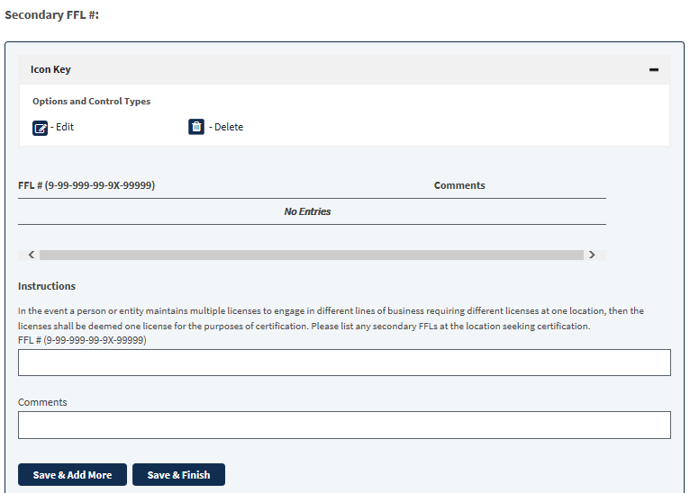
STEP 2: COMPLETE YOUR FIREARM DEALER LICENSE CERTIFICATION APPLICATION
Enter any secondary FFLs you may have. In the comment section, please enter what the FFL is for.
If none, please skip this section and leave blank.
25

Slide 26
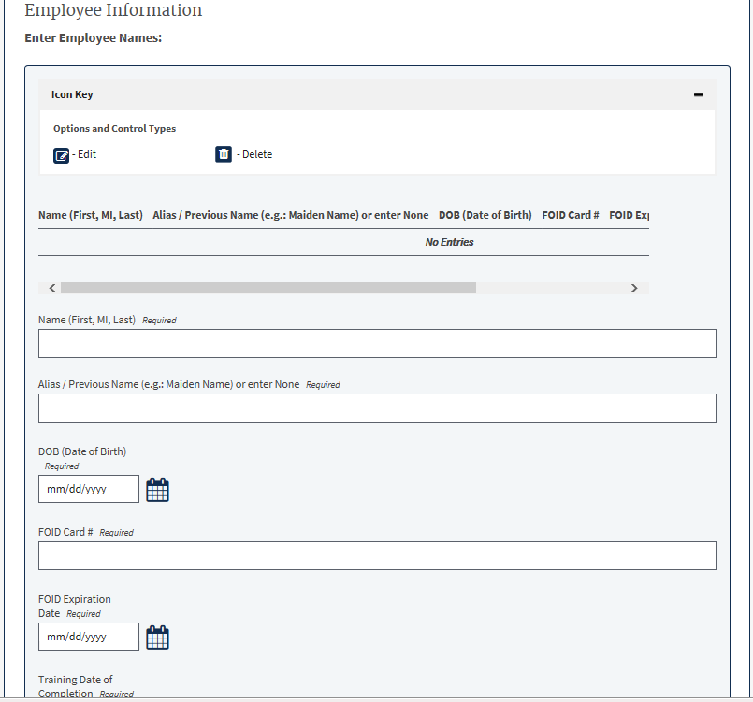
STEP 2: COMPLETE YOUR FIREARM DEALER LICENSE CERTIFICATION APPLICATION
Enter all of your employees information. If you have multiple employees, you will need to select “Save & Add More”.
If you are an owner operator and do not have any employees, enter yourself as the employee.
26

Slide 27
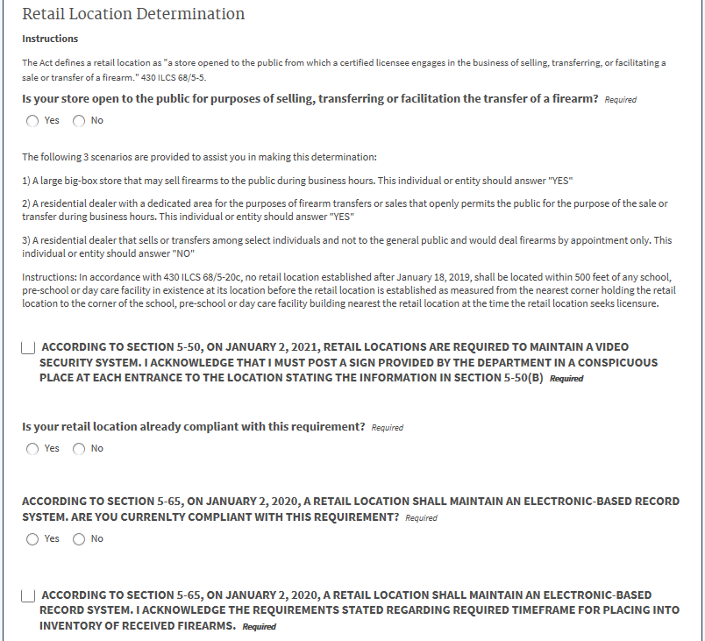
STEP 2: COMPLETE YOUR FIREARM DEALER LICENSE CERTIFICATION APPLICATION
Retail Location Determination ***VERY IMPORTANT***
Please read this section very carefully to determine if you are a retail or a non-retail location. You will have to choose the correct fee later in the application.
You will need to answer all the remaining questions. Depending on your answers; additional questions may populate.
27

Slide 28
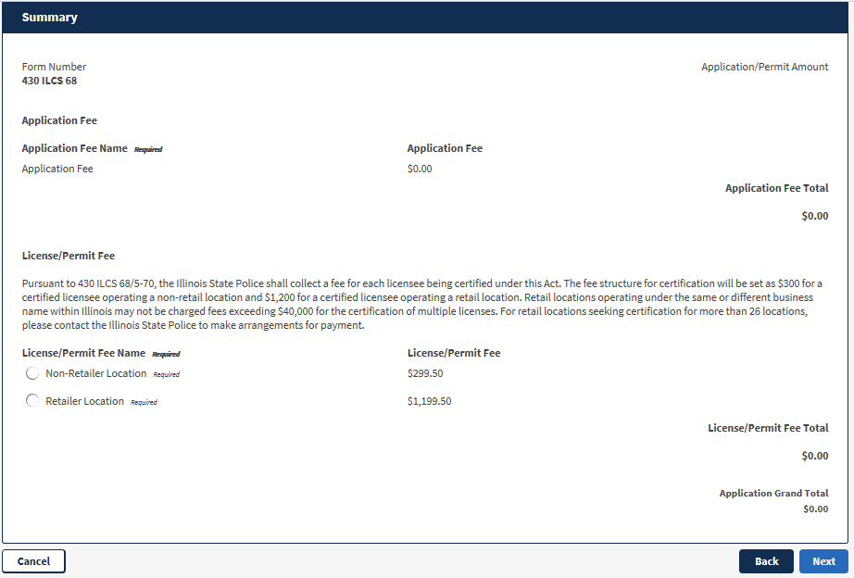
STEP 2: COMPLETE YOUR FIREARM DEALER LICENSE CERTIFICATION APPLICATION
Select the correct fee based upon the determination on the previous slide.
Select “Next”
28

Slide 29
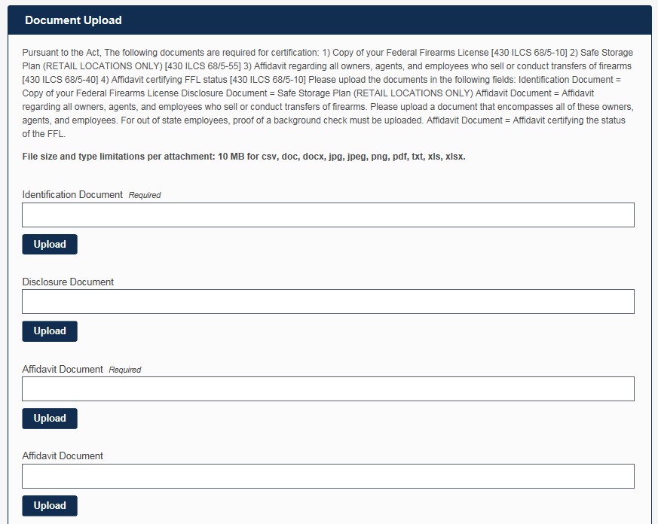
STEP 2: COMPLETE YOUR FIREARM DEALER LICENSE CERTIFICATION APPLICATION
The Document Upload section is where you upload all of your required documents listed on slide #3.
After you upload each document, select “Save.” The upload button will change into the save button.
(i.e. FFL Disclosure Document, Safe Storage Plan (retail only), affidavit for the owner(s), agent(s) and employee(s), background check for out-of-state employees…etc.).
29

Slide 30
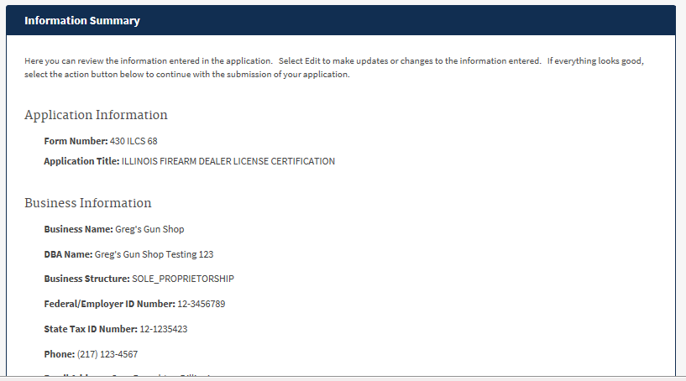
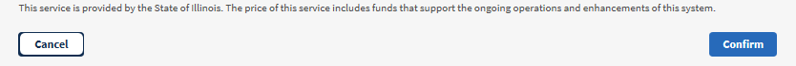
STEP 2: COMPLETE YOUR FIREARM DEALER LICENSE CERTIFICATION APPLICATION
In the Information Summary section, please review your submitted information.
If you notice any corrections that need to be made, select the corresponding “Edit” button below the section containing the incorrect information in order to change it.
Once you are finished select the “Confirm” button at the bottom.
30

Slide 31
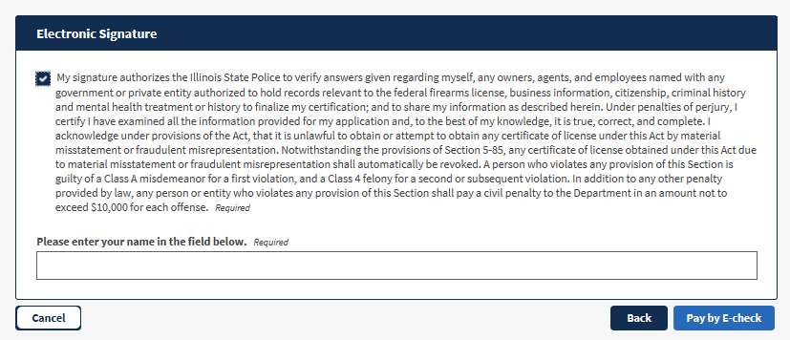
STEP 2: COMPLETE YOUR FIREARM DEALER LICENSE CERTIFICATION APPLICATION
After reading the information above, check the box and type in your full name (First, M.I., Last). Then select “Pay by E-check”.
31

Slide 32
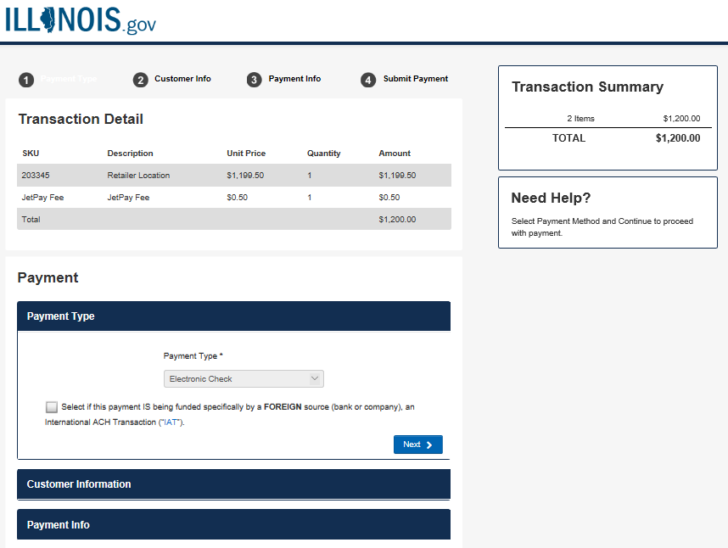
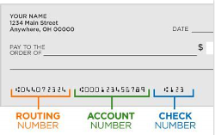
STEP 2: COMPLETE YOUR FIREARM DEALER LICENSE CERTIFICATION APPLICATION
Total amount charged
Fill out the payment information as instructed. There are 3 sections which expand:
Payment Type;
Customer Information; and Payment Info.
In the Payment Info section, you will need to provide your 9-digit routing number and bank account number.
ACH (e-Check) Convenience Fee. JetPay (Vendor) is used by the Illinois State Treasurer.
32

Slide 33
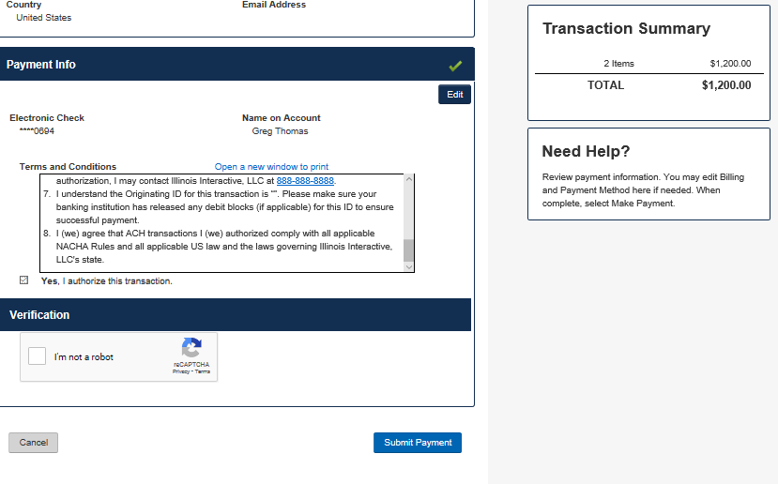
STEP 2: COMPLETE YOUR FIREARM DEALER LICENSE CERTIFICATION APPLICATION
Read the “Terms and Conditions” and select the “Yes” check box.
Enter the Verification Code and select the “Submit Payment” button.
33

Slide 34
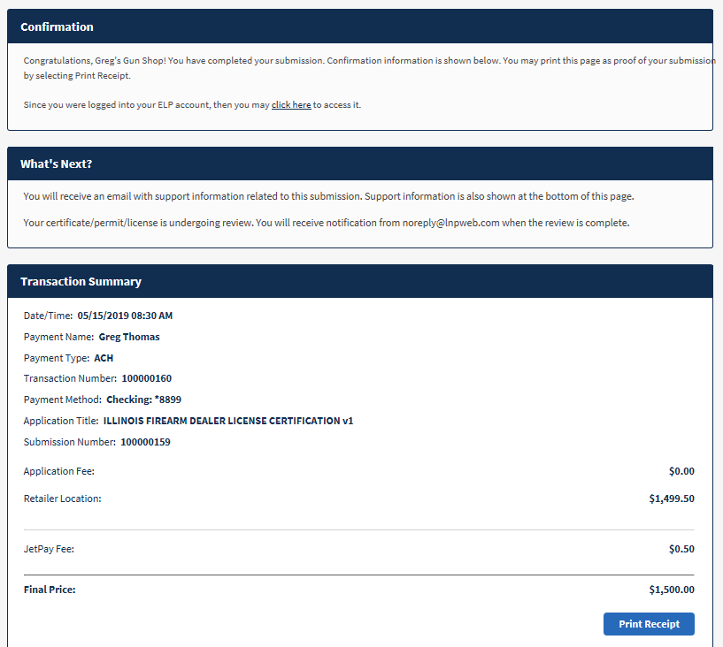
STEP 2: COMPLETE YOUR FIREARM DEALER LICENSE CERTIFICATION APPLICATION
CONGRATULATIONS!! You have submitted your application.
It is recommended you print your receipt using the button at the bottom right hand corner.
Keep this receipt and the email sent to your in-box in the event you need any further assistance. The information located within these documents will help ISP look up your application.
34

Slide 35
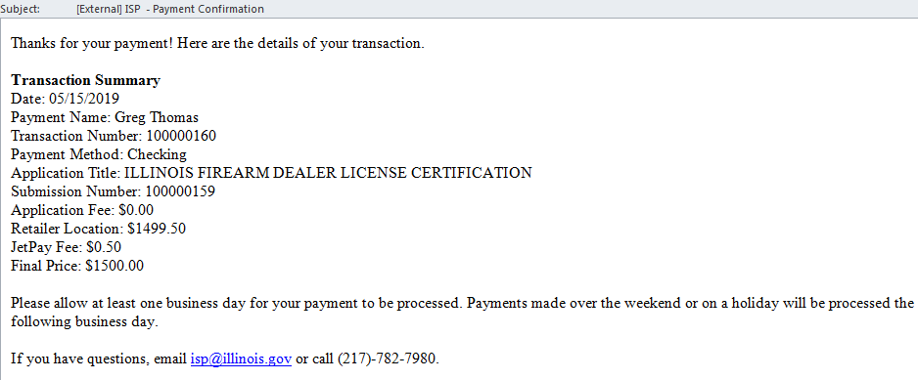


STEP 2: COMPLETE YOUR FIREARM DEALER LICENSE CERTIFICATION APPLICATION
Example of the Payment Confirmation email you will receive. $1200.00
ACH (e-Check) Convenience Fee. JetPay (Vendor) is used by the Illinois State Treasurer.
Total amount charged
35

Slide 36
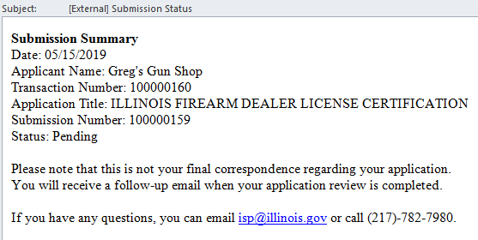
STEP 2: COMPLETE YOUR FIREARM DEALER LICENSE CERTIFICATION APPLICATION
Example of the Submission Status email you will receive - Pending
36

Slide 37
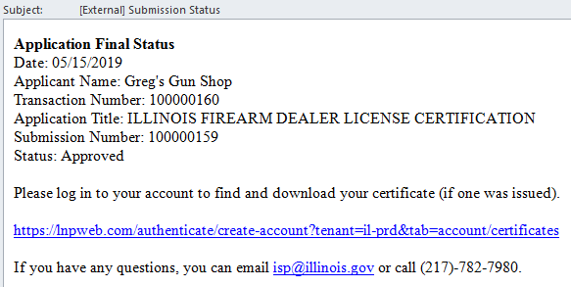
STEP 2: COMPLETE YOUR FIREARM DEALER LICENSE CERTIFICATION APPLICATION
Example of the Submission Status Update email you will receive. An email will be sent once there is a change in your submission status.
37

Slide 38
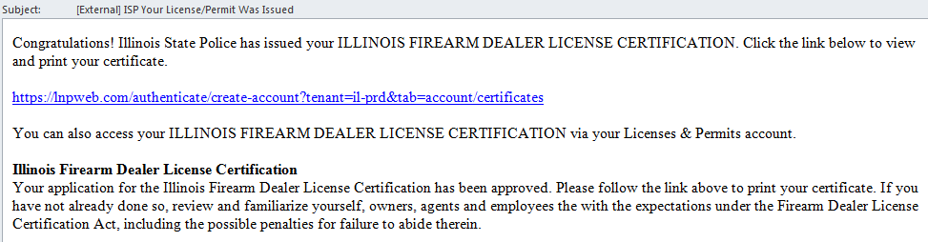
STEP 2: COMPLETE YOUR FIREARM DEALER LICENSE CERTIFICATION APPLICATION
Example of the Firearm Dealer License Certification email. The hyperlink will direct you to your certificate.
Select the blue hyperlink to print your certificate
38

Slide 39
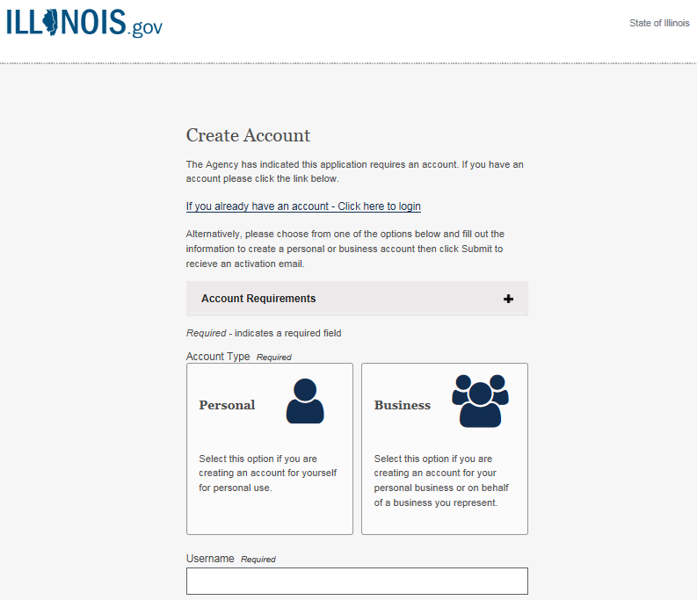
STEP 2: COMPLETE YOUR FIREARM DEALER LICENSE CERTIFICATION APPLICATION
Select hyperlink to log/sign-in into your account. Enter your username and password when asked.
39

Slide 40
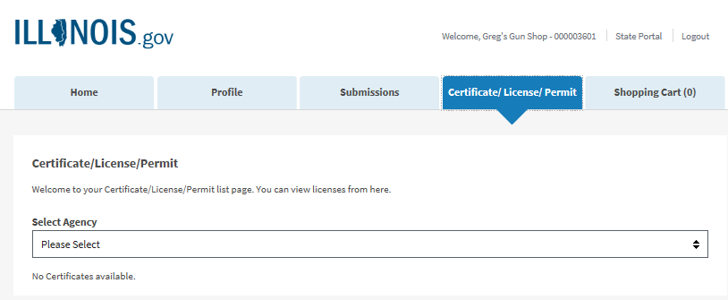
STEP 2: COMPLETE YOUR FIREARM DEALER LICENSE CERTIFICATION APPLICATION
Once logged in, select the “Certificate/License/Permit tab at the top. Use the “Select Agency” drop down menu to select “Illinois State Police”
40

Slide 41
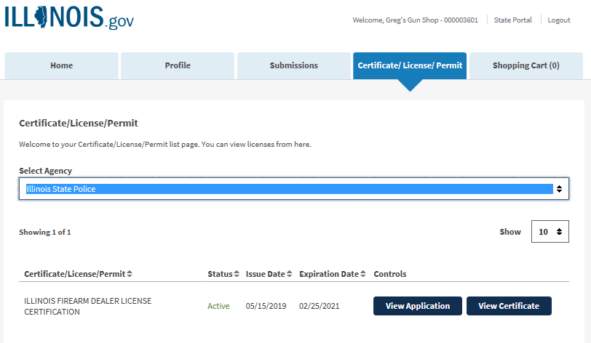
STEP 2: COMPLETE YOUR FIREARM DEALER LICENSE CERTIFICATION APPLICATION
To print your certificate, select the “View Certificate” button below. You will be given the option to open or save once you select the button.
If you would like to view your submitted application, you may select “View Application”.
41

Slide 42
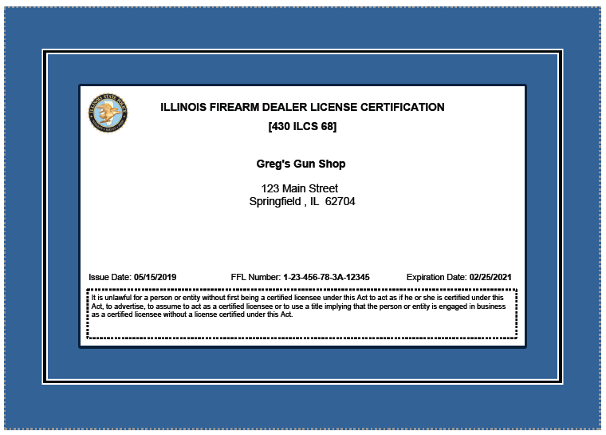
STEP 2: COMPLETE YOUR FIREARM DEALER LICENSE CERTIFICATION APPLICATION
This is an example certificate. Your certificate will contain the information you submitted within the application.
If you notice an error in spelling, incorrect address, etc…it was submitted on your application in error. The ISP cannot correct the information.
Please make note of the expiration date. This corresponds to your submitted FFL expiration date.
------SAMPLE -------
42

Slide 43
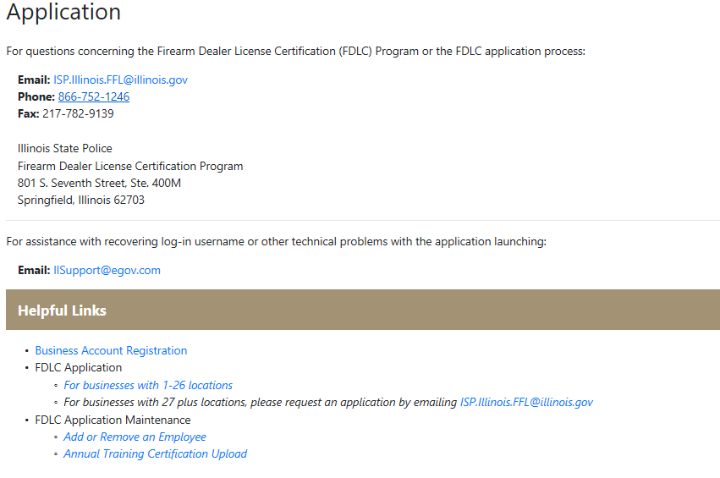
Dealer Employee Change Form &
Dealer Employee Annual Training Form
These 2 links to preform your application maintenance do not require a fee ($).
To update your employee list and upload annual training certifications, use these 2 links.
These links are only to be used for updating information after you submit your application to keep it up-to-date.
43

